Slide 1


Logistics Regression for
Text Classification

Slide 2
TABLE OF CONTENT
01
Classical Machine Learning Techniques for NLP
02
Neural-based Roadmap of NLP
03
Logistics Regression for Text Classification
04
Demonstration and Assignment

Slide 3
Classical Machine Learning Techniques for NLP
Classical Machine Learning Techniques for NLP
Machine Learning Task
The tf.idf weights
Neural-based approach

Slide 4

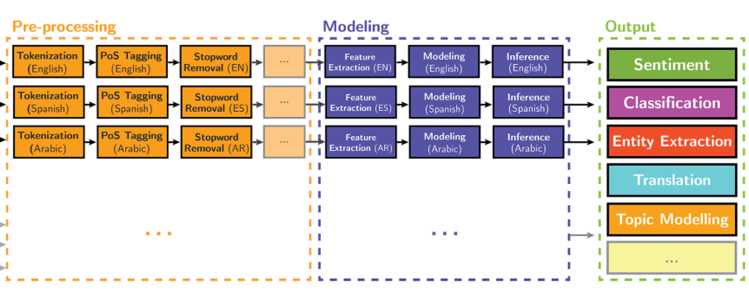

Slide 5
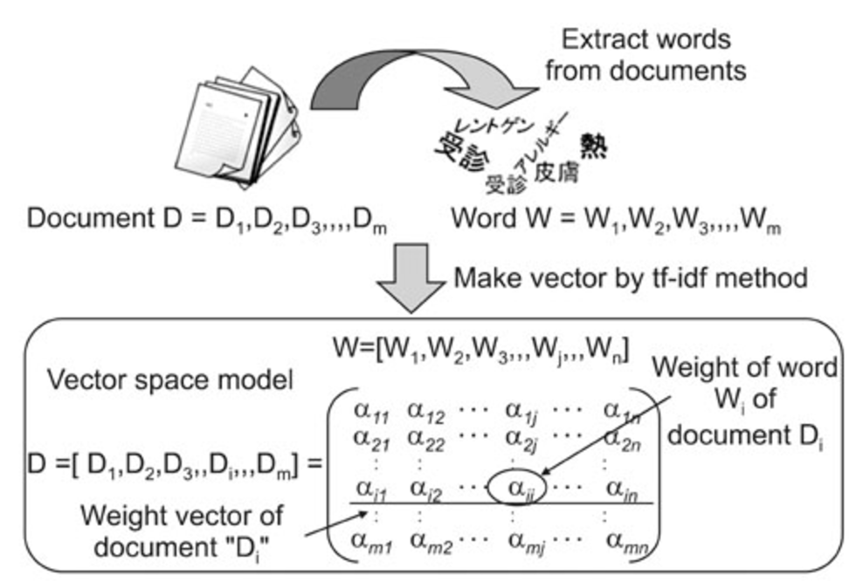


Slide 6
Classical Machine Learning Techniques for NLP
Document Collection
A collection of n documents can be represented in the vector space model by a term-document matrix.
An entry in the matrix corresponds to the “weight” of a term in the document; zero means the term has no significance in the document or it simply doesn’t exist in the document.
T₁ T₂ …. T_{t}
D₁ w₁₁ w₂₁ … w_{t1}
D₂ w₁₂ w₂₂ … w_{t2}
: : : :
: : : :
D_{n} w_{1n} w_{2n} … w_{tn}

Slide 7
Classical Machine Learning Techniques for NLP
Term Weights: Term Frequency
More frequent terms in a document are more important, i.e. more indicative of the topic.
f_{ij} = frequency of term i in document j
May want to normalize term frequency (tf) by dividing by the frequency of the most common term in the document:
tf_{ij} = f_{ij} / max_{i}{f_{ij}}

Slide 8
Classical Machine Learning Techniques for NLP
Term Weights: Inverse Document Frequency
Terms that appear in many different documents are less indicative of overall topic.
df _{i} = document frequency of term i
= number of documents containing term i
idf_{i} = inverse document frequency of term i,
= log₂ (N/ df _{i})
(N: total number of documents)
An indication of a term’s discrimination power.
Log used to dampen the effect relative to tf.

Slide 9
Classical Machine Learning Techniques for NLP
TF-IDF Weighting
A typical combined term importance indicator is tf-idf weighting:
w_{ij} = tf_{ij} idf_{i} = tf_{ij} log₂ (N/ df_{i})
A term occurring frequently in the document but rarely in the rest of the collection is given high weight.
Many other ways of determining term weights have been proposed.
Experimentally, tf-idf has been found to work well.
‹#›

Slide 10
Classical Machine Learning Techniques for NLP
Computing TF-IDF -- An Example
Given a document containing terms with given frequencies:
A(3), B(2), C(1)
Assume collection contains 10,000 documents and
document frequencies of these terms are:
A(50), B(1300), C(250)
Then:
A: tf = 3/3; idf = log₂(10000/50) = 7.6; tf-idf = 7.6
B: tf = 2/3; idf = log₂ (10000/1300) = 2.9; tf-idf = 2.0
C: tf = 1/3; idf = log₂ (10000/250) = 5.3; tf-idf = 1.8

Slide 11
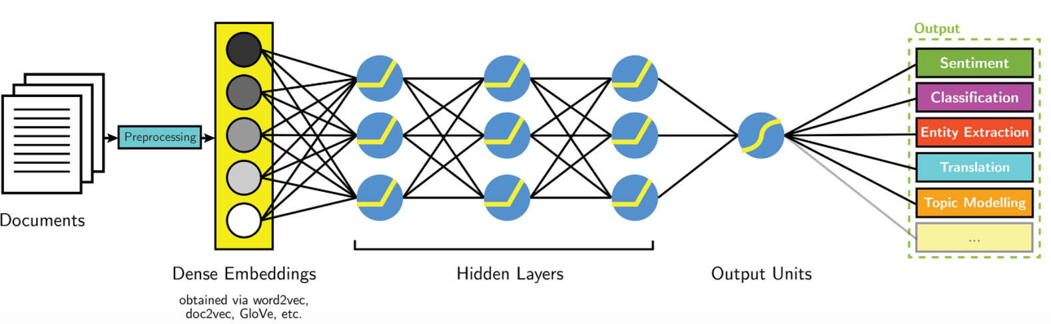
Classical Machine Learning Techniques for NLP
Neural-based Approaches

Slide 12
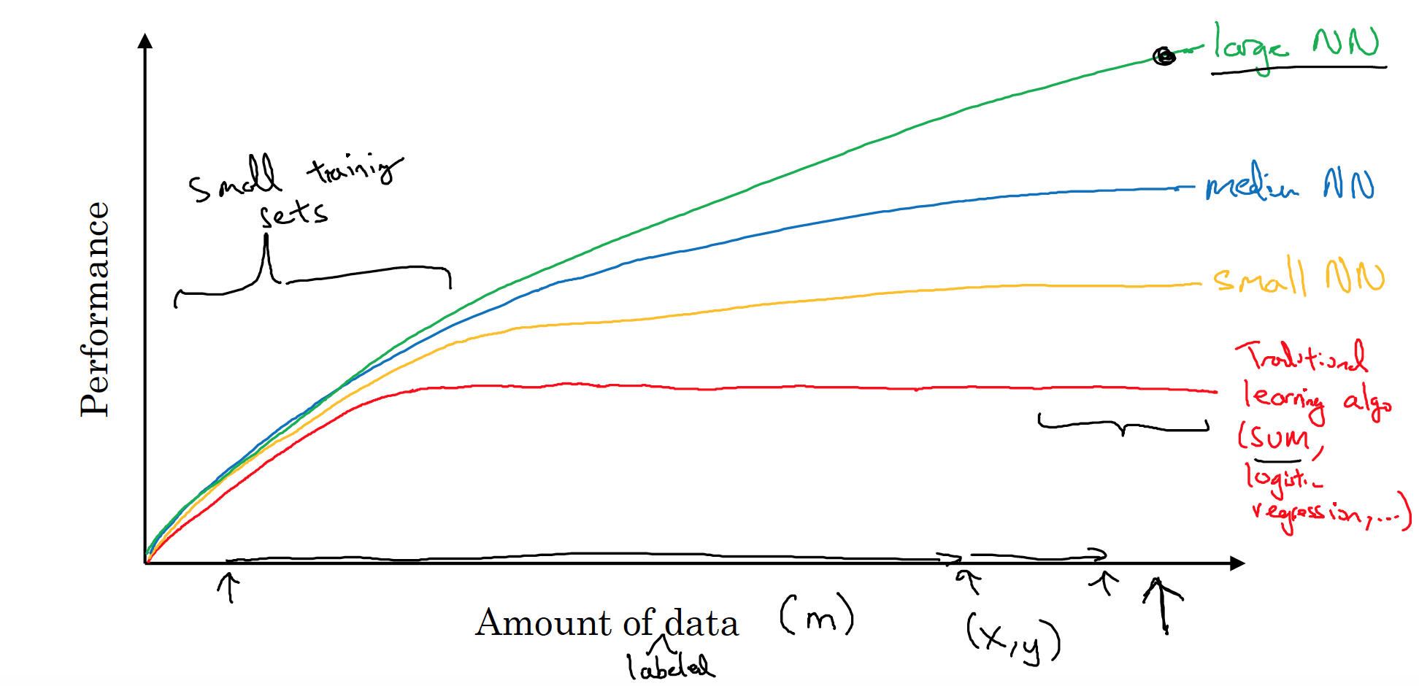
Classical Machine Learning Techniques for NLP
Why Neural?

Slide 13
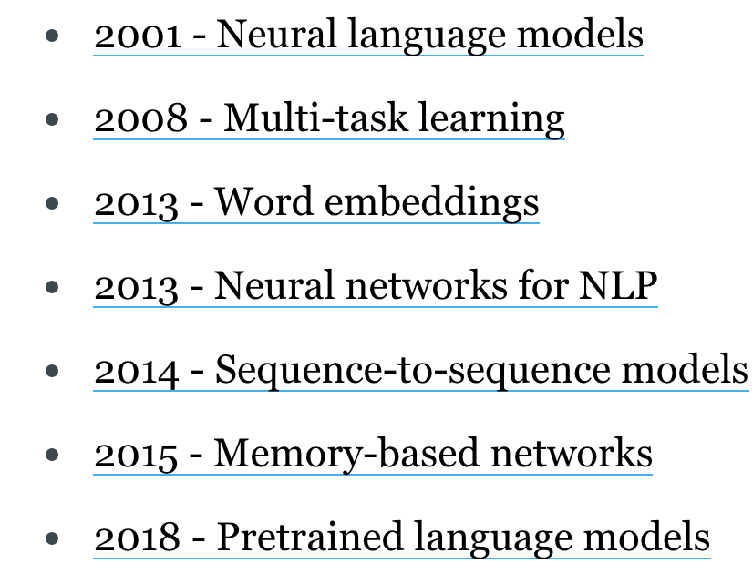
Classical Machine Learning Techniques for NLP
Neural-based Milestones for NLP
Character-based representations
Adversarial learning
Reinforcement learning
Conditional random fields
Bleu Latent Dirichlet Allocation Wikipedia exploitation

Slide 14
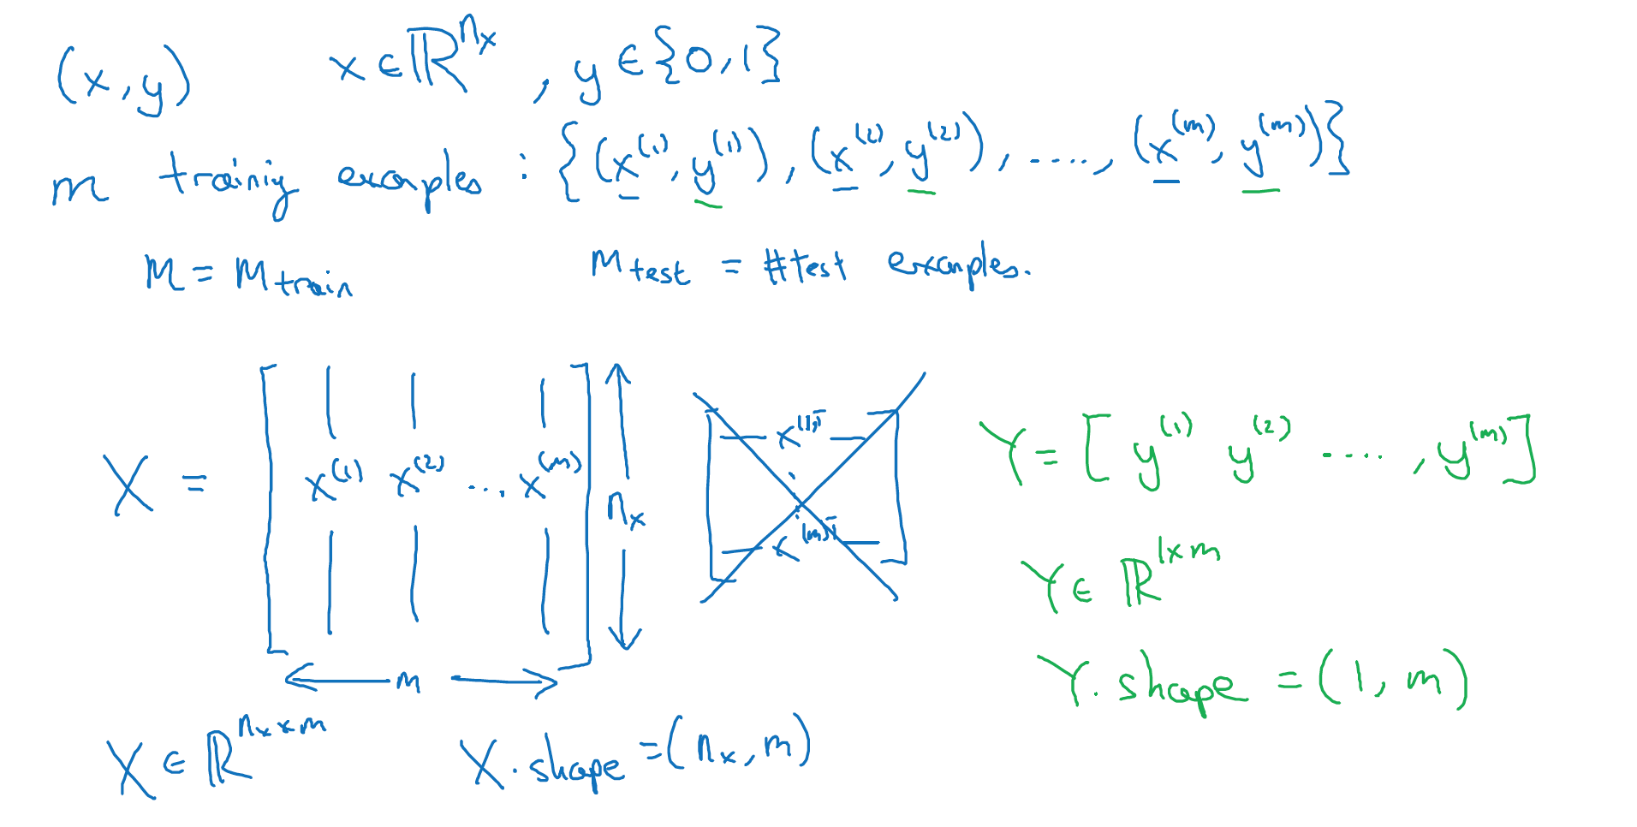
Classical Machine Learning Techniques for NLP
Supervised Learning Problem

Slide 15
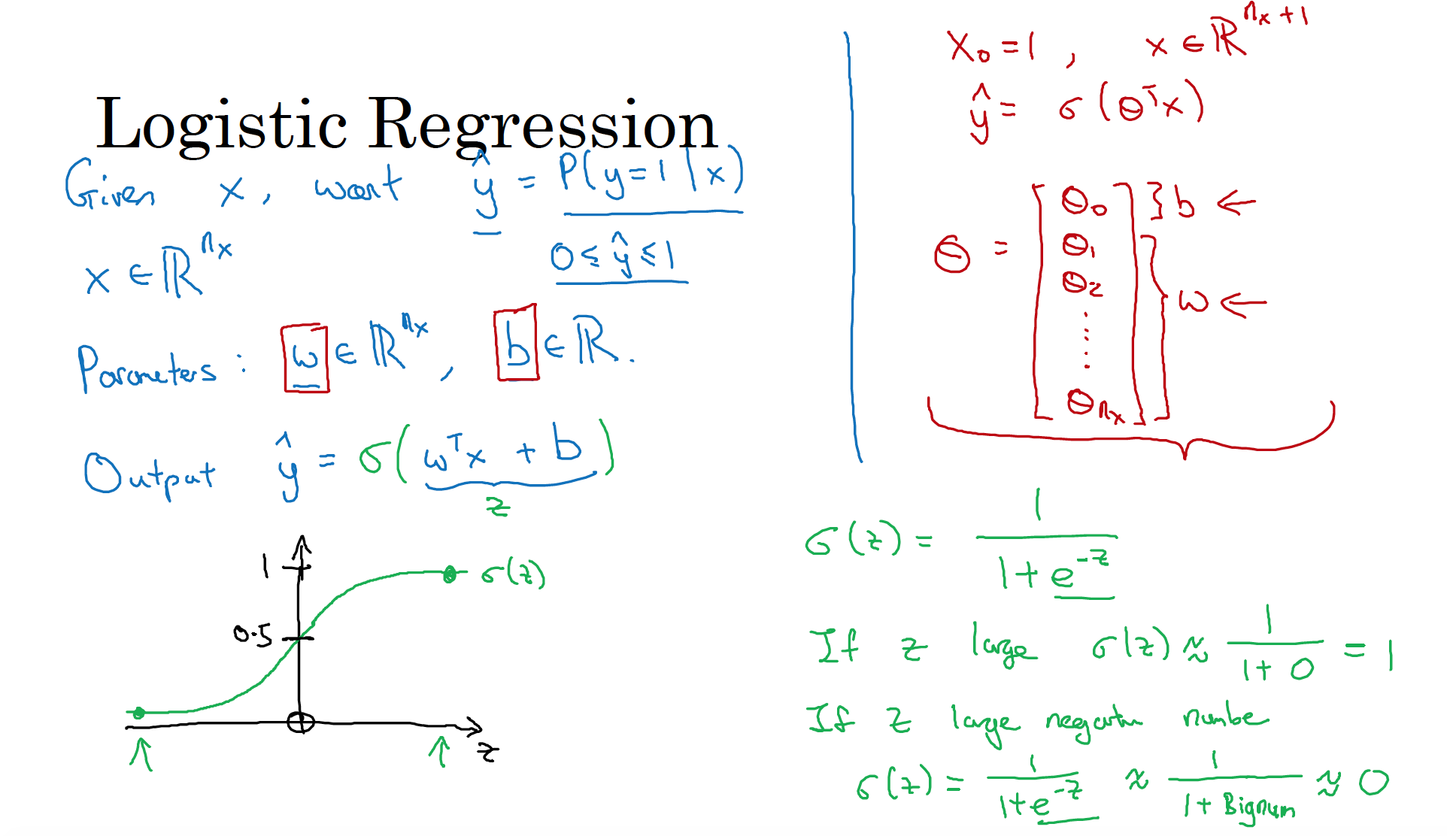
Classical Machine Learning Techniques for NLP

Slide 16
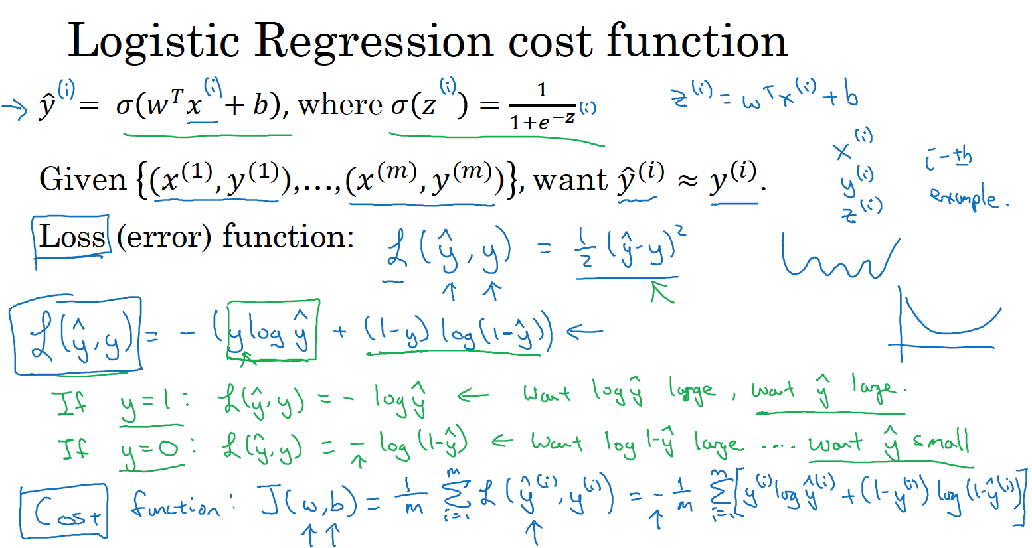
Classical Machine Learning Techniques for NLP

Slide 17
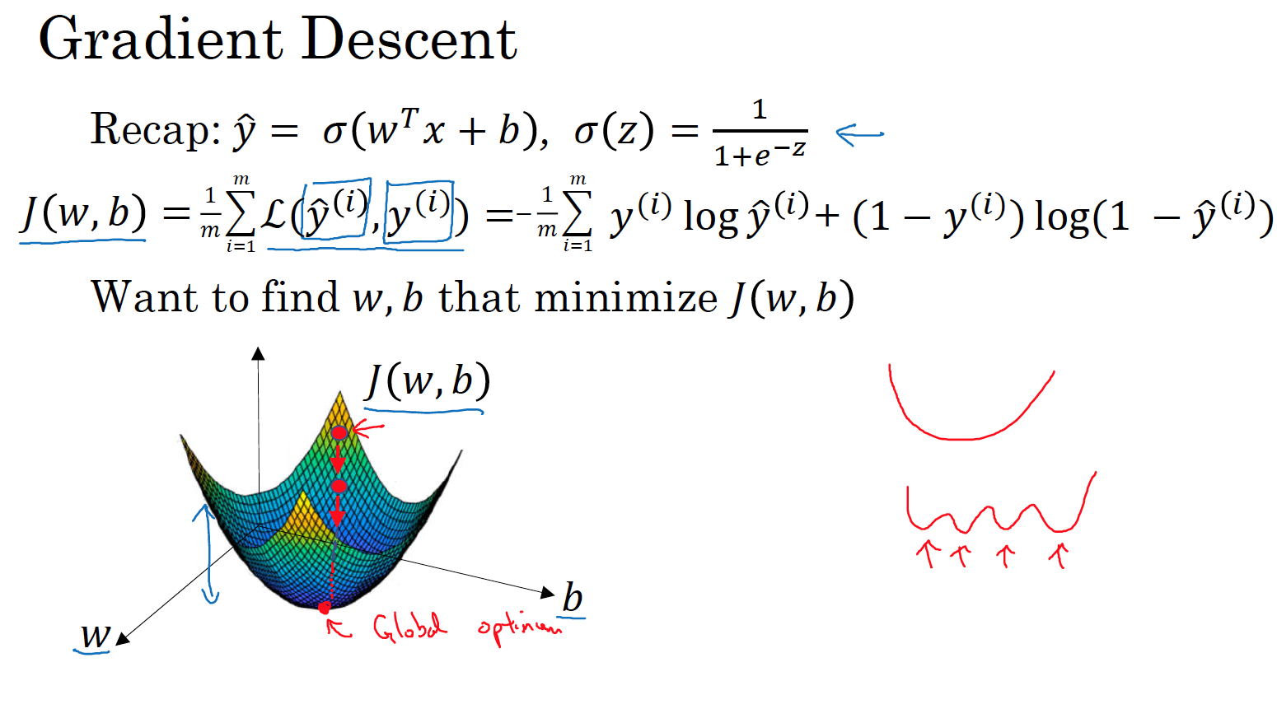
Classical Machine Learning Techniques for NLP

Slide 18
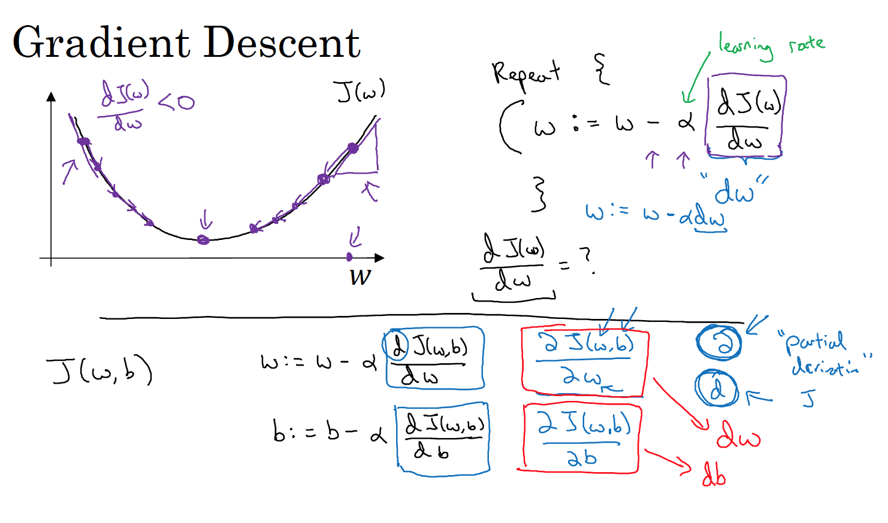
Classical Machine Learning Techniques for NLP

Slide 19
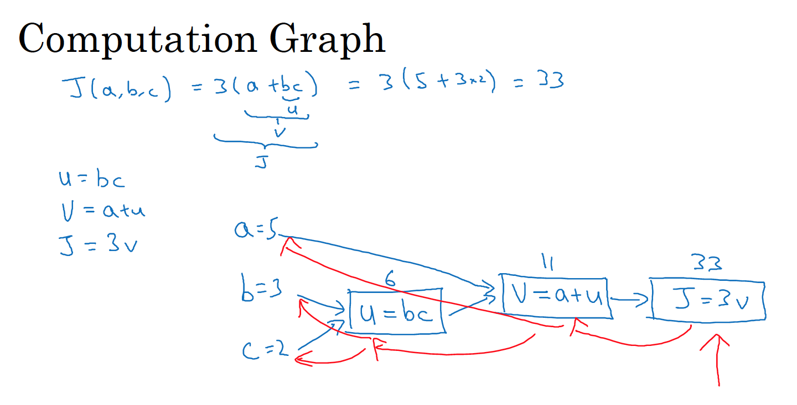
Classical Machine Learning Techniques for NLP

Slide 20
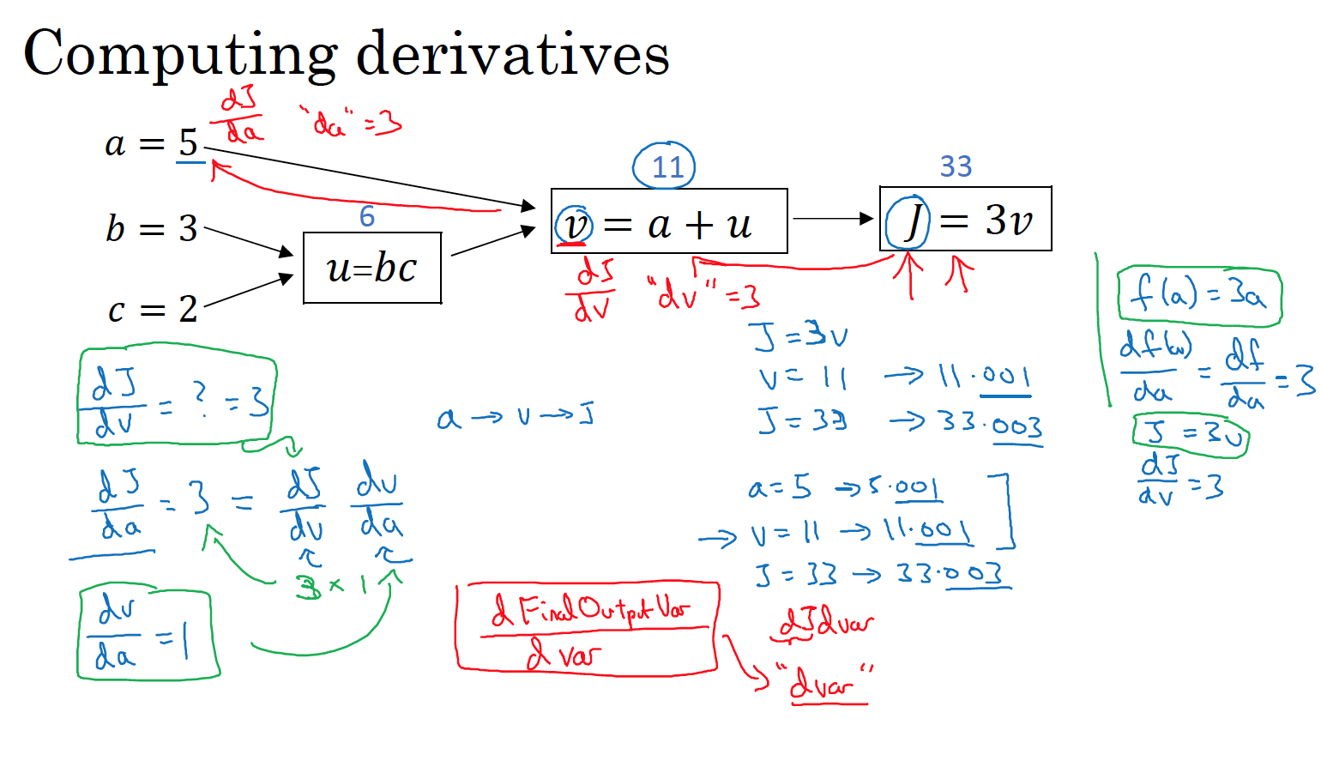
Classical Machine Learning Techniques for NLP

Slide 21
Classical Machine Learning Techniques for NLP

Slide 22
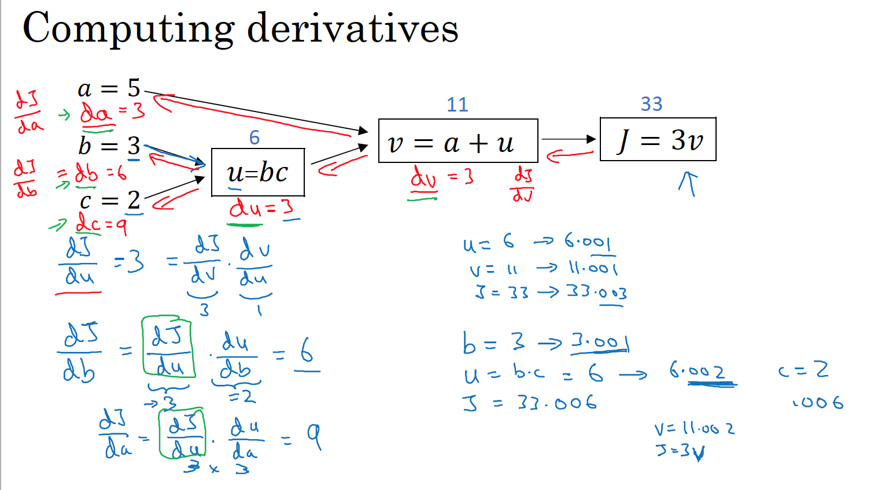
Classical Machine Learning Techniques for NLP

Slide 23
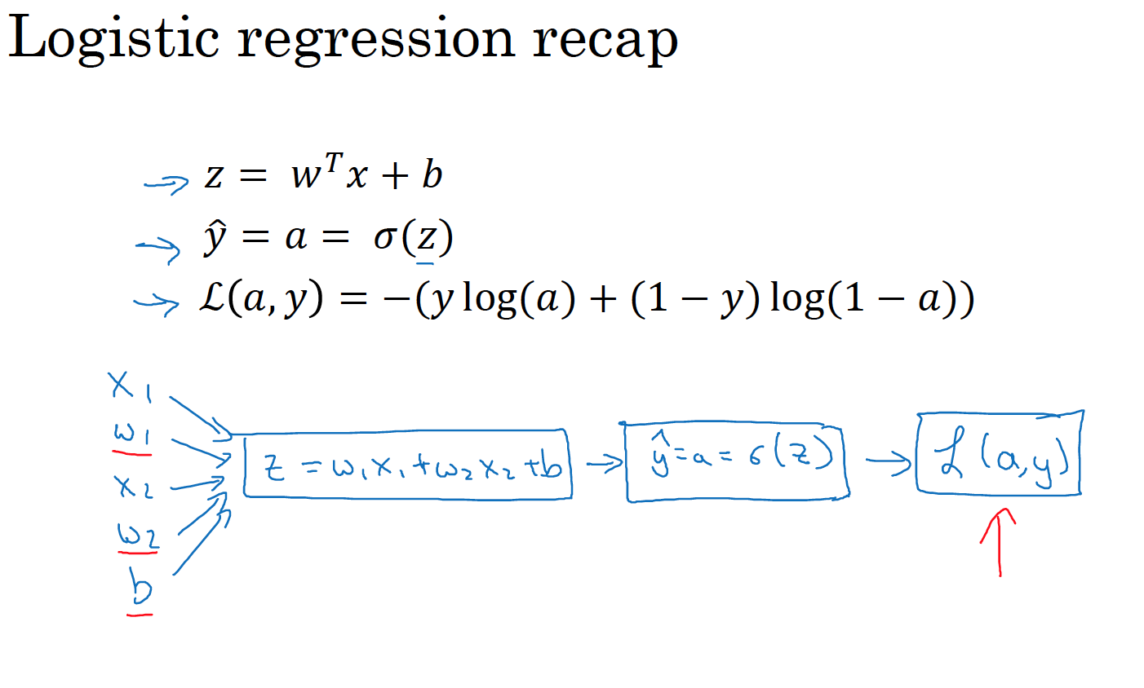
Classical Machine Learning Techniques for NLP

Slide 24
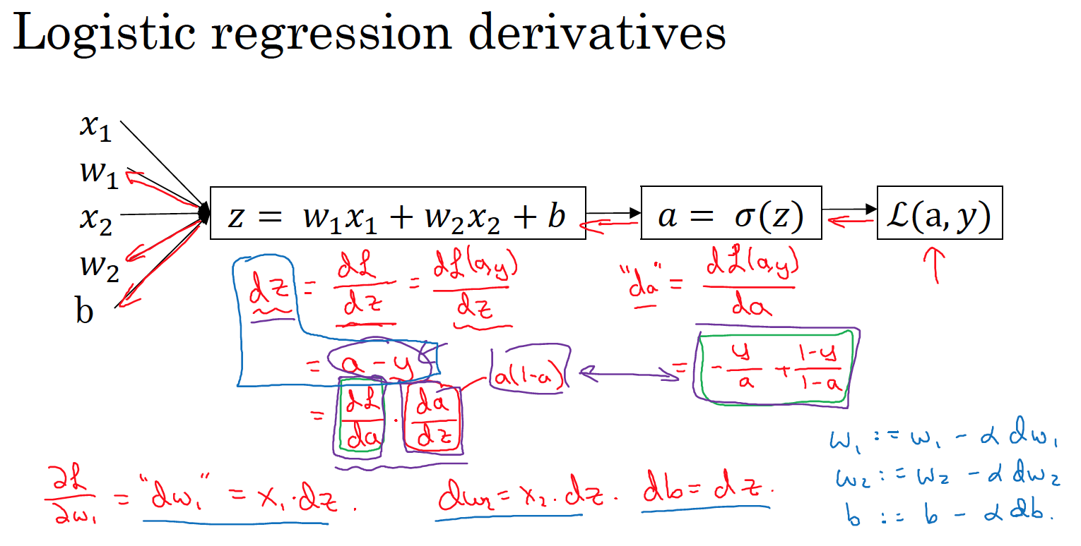
Classical Machine Learning Techniques for NLP

Slide 25
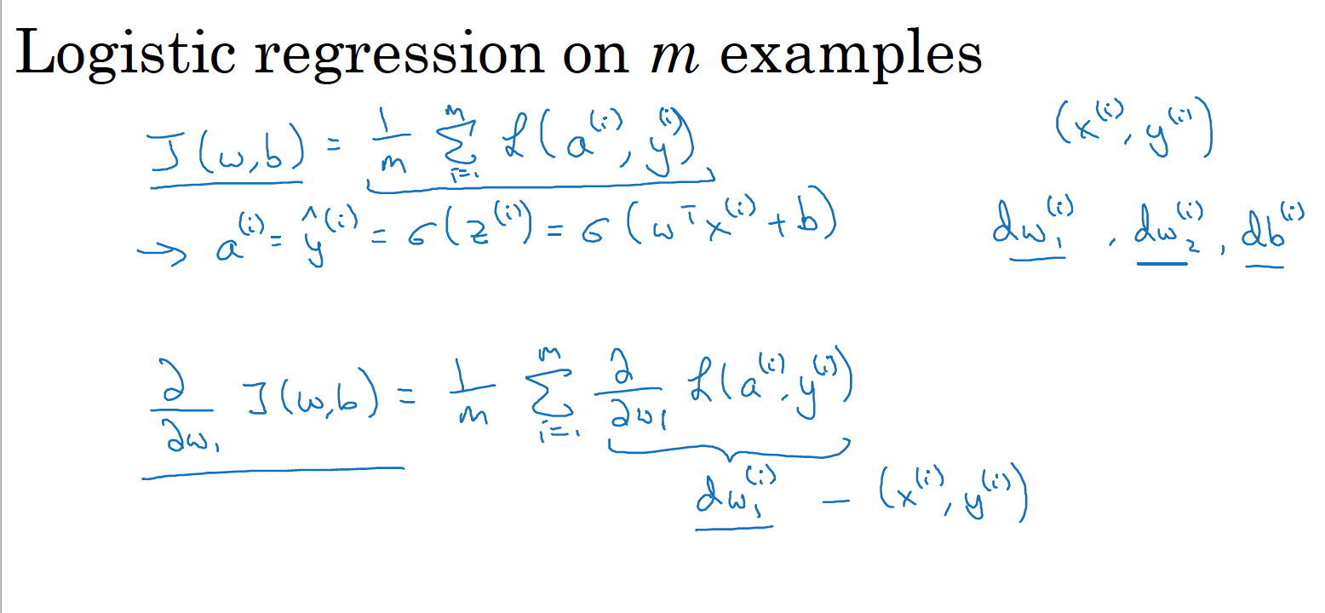
Classical Machine Learning Techniques for NLP

Slide 26
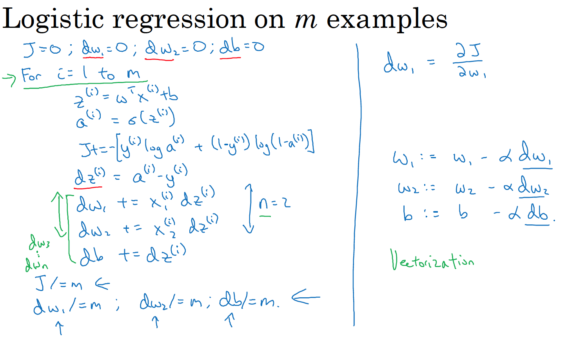
Classical Machine Learning Techniques for NLP

Slide 27
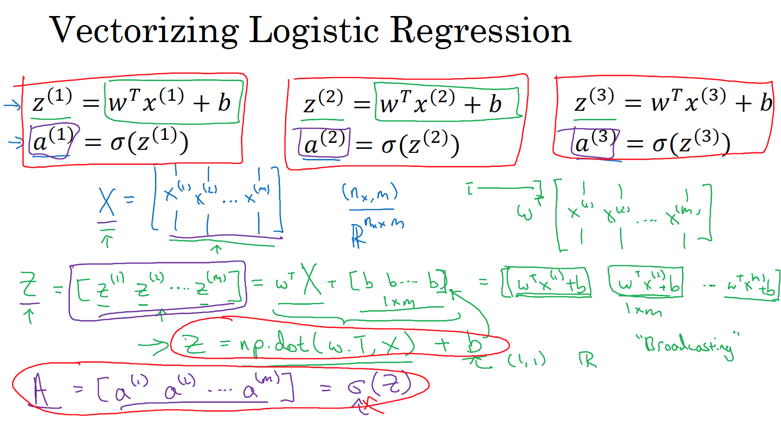
Classical Machine Learning Techniques for NLP

Slide 28
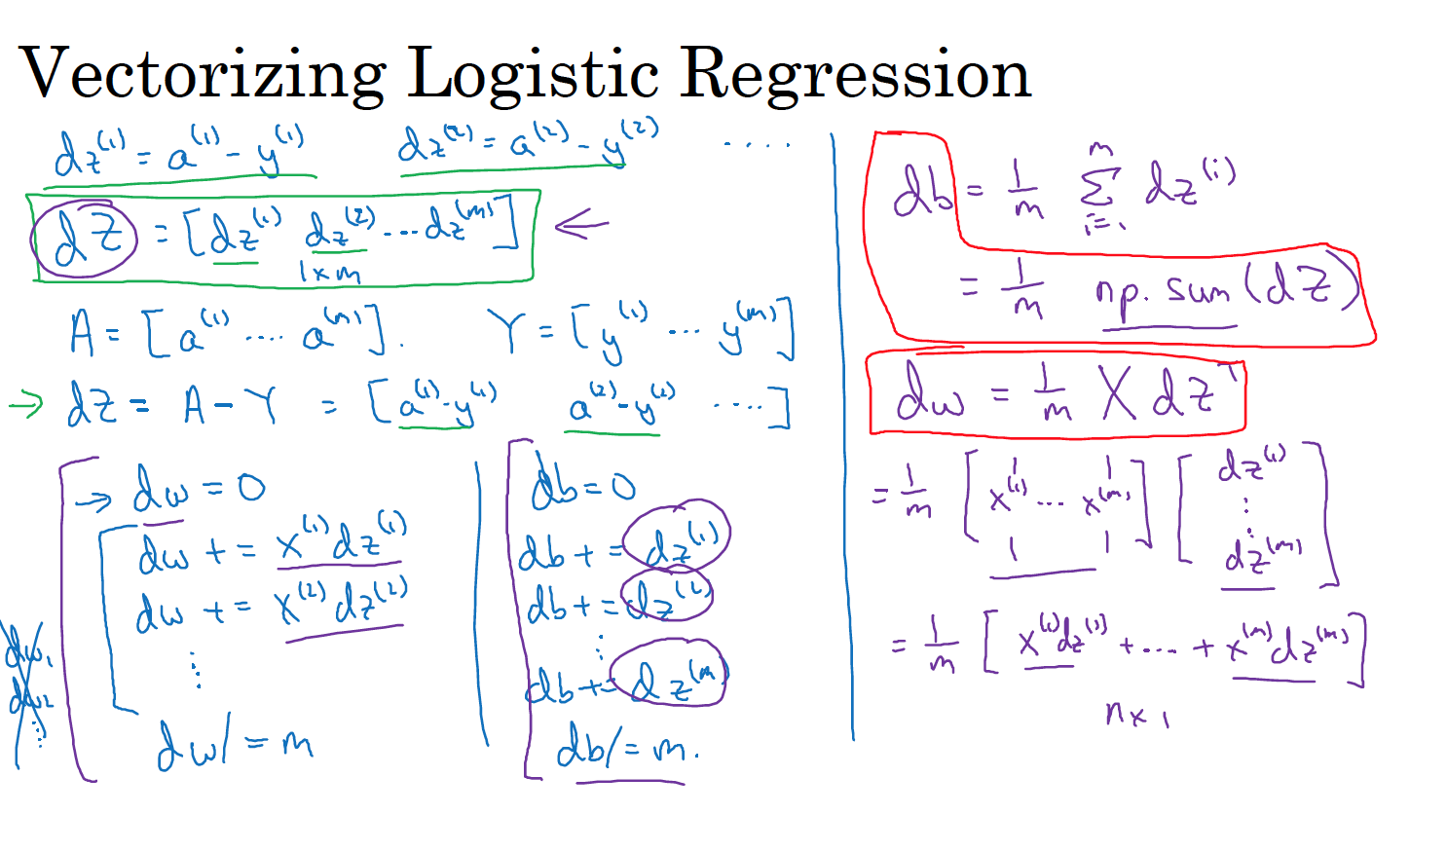
Classical Machine Learning Techniques for NLP

Slide 29
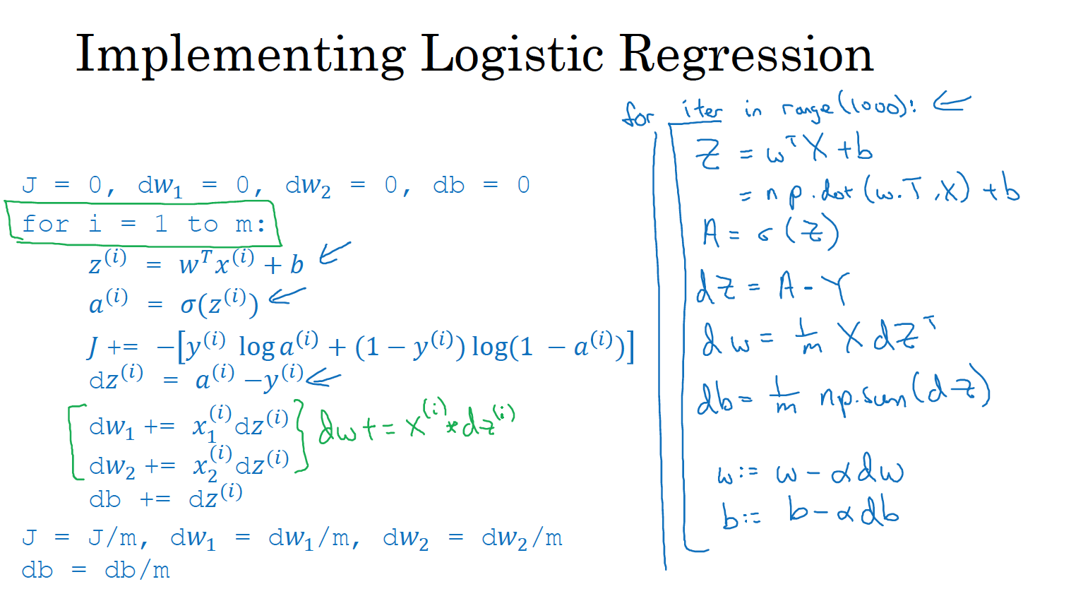
Classical Machine Learning Techniques for NLP

Slide 30
Thank you for
your attention

